Slide 1

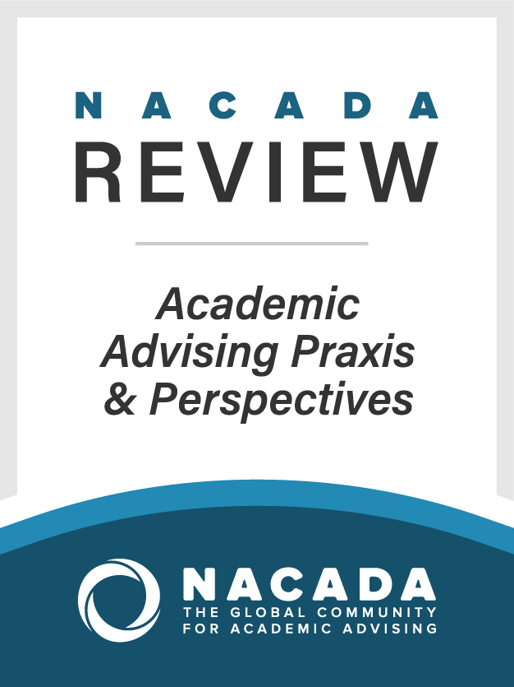
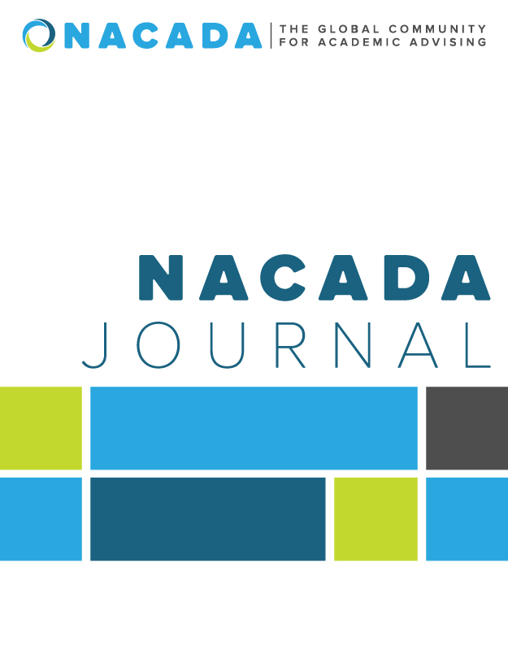
Publish with NACADA:
Find the appropriate NACADA venue for your writing
2020 Region __ Conference Presenters:
Presenter 1 Name, Sample: Asst Director for Resources, NACADA
Managing Editor NACADA Review & NACADA Journal
Presenter 2 Name, Title…..
Notes:
Welcome and introductions

Slide 2
Scholarship and the advising practice: three good reasons
Four stages of professionalization
1. Creating occupations
2. Establishing schools
3. Forming associations
4. Ratifying codes
Empowerment
Research
is
Power
Continuous improvement
through praxis:
practice based on theory
or
doing based on understanding
Notes:
A few perspectives on the importance of scholarship for associations like NACADA, and particularly those within the profession who are usually not associated with research and scholarly work.
The four stages is based on Shaffer, L.S., Zalewski J.M. and Leveille, J. 2010. The Professionalization of Academic Advising: Where Are We in 2010? NACADA Journal 30(1), 66-77 and describes the descriptive as well as desired evolution of successful professions;
The second claim is based on shared experience: research means recognition, power, influence, in academia;
The third claim relates to my upcoming article in the Review, and other articles that state in various ways that professionalism lies in the thoughtful and systematic approach of what one does, makes, creates, implements, etc. The relationship between theory and practice leads up to the next slide, which introduces Boyer.

Slide 3
Aspects of scholarship
Ernest Boyer (1990)
Discovery
Application
Integration
Teaching
and Learning
Notes:
Boyer remains a source of great inspiration and clarity on the concept of scholarship. Note that some speak of more or less separate domains of scholarship, while other argue that these are integrated aspects, and that the ideal scholar engages in all four of them. I belong to the latter school and see this as extremely relevant for the equation between scholarship and professionalism. But the aspects leave room for preference and emphasis, and offer varies ‘entries’ into research and scholarship that will suit various people.

Slide 4

260+ members wrote for NACADA venues in 2019
NACADA Blog
Academic Advising Today (AAT)
NACADA book reviews
The NACADA Review: Academic Advising Praxis & Perspectives
The NACADA Journal
NACADA books
Notes:
Are there any previous writers, reviewers, or Publications Advisory Board or Research Committee members in the room?

Slide 5
By the way….
This presentation is available on the Writing for NACADA webpage, which also has lots of good resources….
RESOURCES
  WRITING FOR NACADA - http://www.nacada.ksu.edu/Resources/Writing-for-NACADA.aspx
  WRITER SUPPORT –
  https://nacada.ksu.edu/Resources/Research-Center/Writer-Support.aspx

Slide 6

What we’ll talk about today…
Purpose
Content
Writing Guidelines
Acceptance Process
How do I get published…?
Notes:
You’ll hear us introduce and develop some consistent themes today that apply to almost any kind of writing that you do whether with NACADA or another venue.

Slide 7


What would you like to contribute to the literature?
Write down at least one idea you have for writing about an advising-related issue
and/or
a question you have about writing for NACADA.
Notes:
(NOTE: they are attending the session for a reason . . . Ask them to write down an idea.)
(If you choose to do this, it’s a good way to jumpstart sampling a writing process . . . Time this carefully:
30 seconds: jot down an idea
1 minute: pair up and explain the idea as clearly as you can to someone
1 minute: switch
30 seconds: now go back and jot a few more notes down on your idea . . . What came to mind as you were talking or listening that you don’t want to forget?
Now . . . People often ask, “How do I even get started with writing?” There you go! Think – write – share – think – write – repeat (and read some)

Slide 8
The continuum of NACADA publications
Reviews:
Books
Articles
NACADA Blog
NACADA Review
NACADA Journal
AAT
Notes:
In the short time we have today we’ll talk about our current “continuum” of publication outlets. As we move through the venues we’ll talk about the scope and purpose of each, along with a few tips about guidelines.

Slide 9
NACADA Publications Philosophy
Research, theory, and practice
Research
  Qualitative and quantitative research
  Humanities-based research
  Critical analysis
Theory
  Applying existing theory to academic advising
  Developing new theory relevant to advising
Advising Practice
Notes:
NACADA venues focus on the intersection of research, theory, and practice. While one venue may focus on one of these three components in more depth than the other two, all three components are vital for a balanced article in any of the venues.

Slide 10
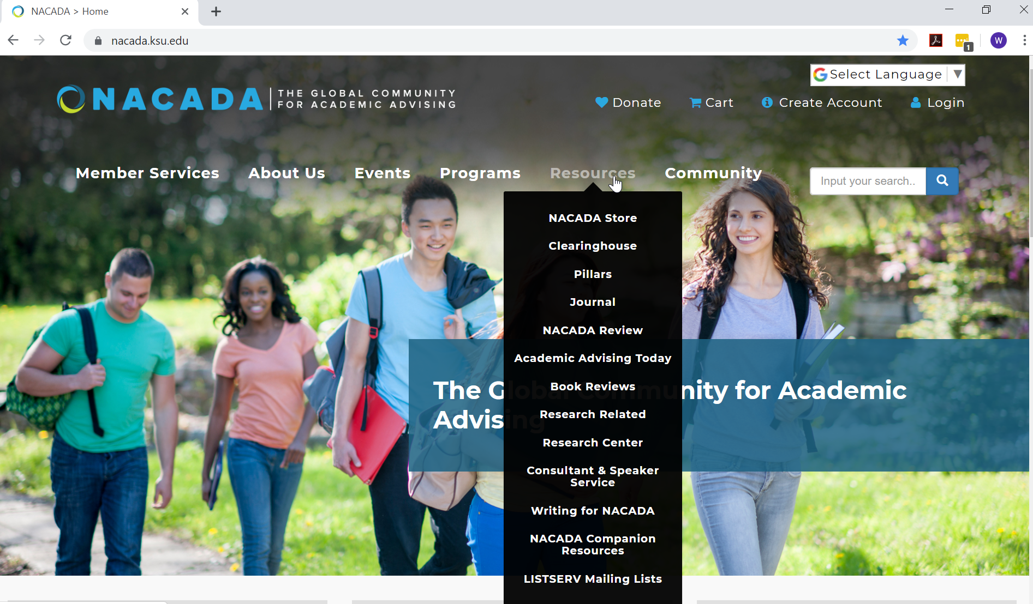
Notes:
All of this information is found in the “Resources” tab of the NACADA website

Slide 11
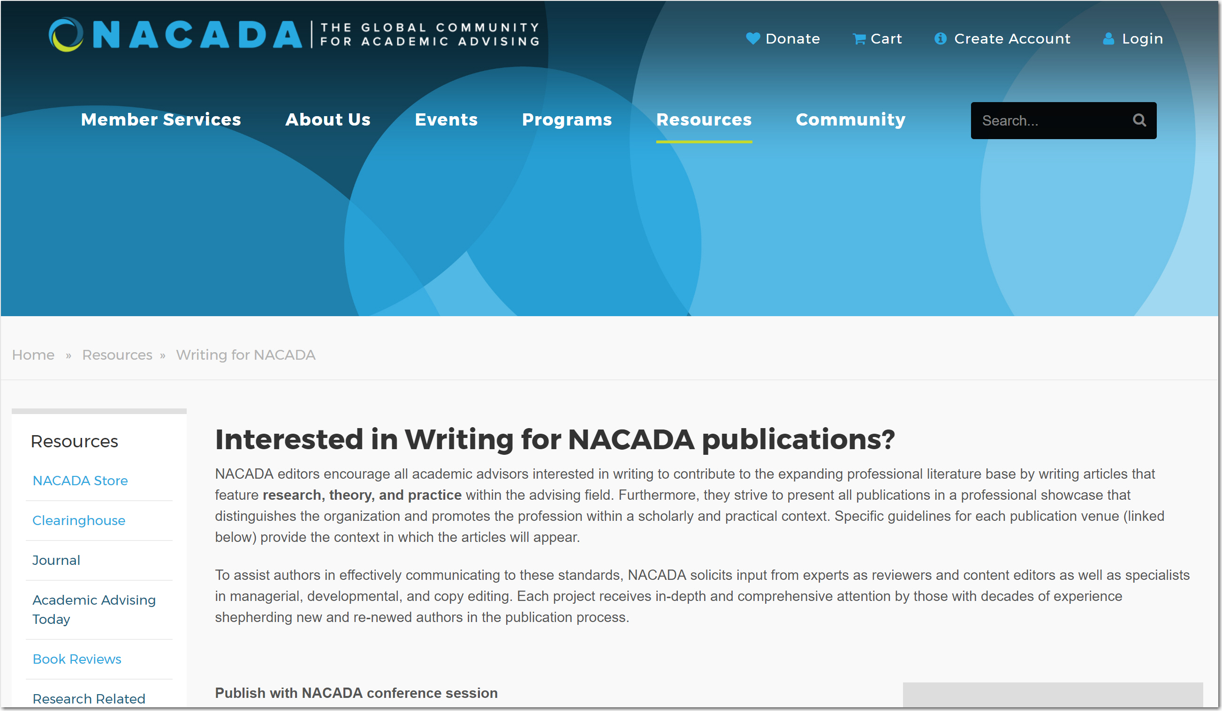
https://www.nacada.ksu.edu/Resources/Writing-for-NACADA.aspx
Notes:
By the way, all of this information and MUCH more is available on our webpage, under the “Writing for NACADA” tab
So let’s get started and talk first about blogging…

Slide 12


“Concise” NACADA Publication options
Submissions should be:
About an advising/student success related NACADA experience
Educational in nature, positive in tone, & focused on particular aspects of academic advising
Original and written especially for the NACADA blog
Both product- and vendor-neutral, and non-political
Notes:
This slide offers an opportunity to introduce key concepts like “educational in nature,” or “product-neutral.”
The W (Wordpress) symbol is at the bottom right of all NACADA webpages.

Slide 13

“Concise” NACADA Publication options
Writing Guidelines
To the point, roughly 400 words
Use 1st person singular. Writing in a conversational tone engages readers; advisors like hearing personal stories.
Bulleted format and urls when appropriate
No peer review, minimal copy editing
Images are effective! Contact nblog@ksu.edu

Slide 14
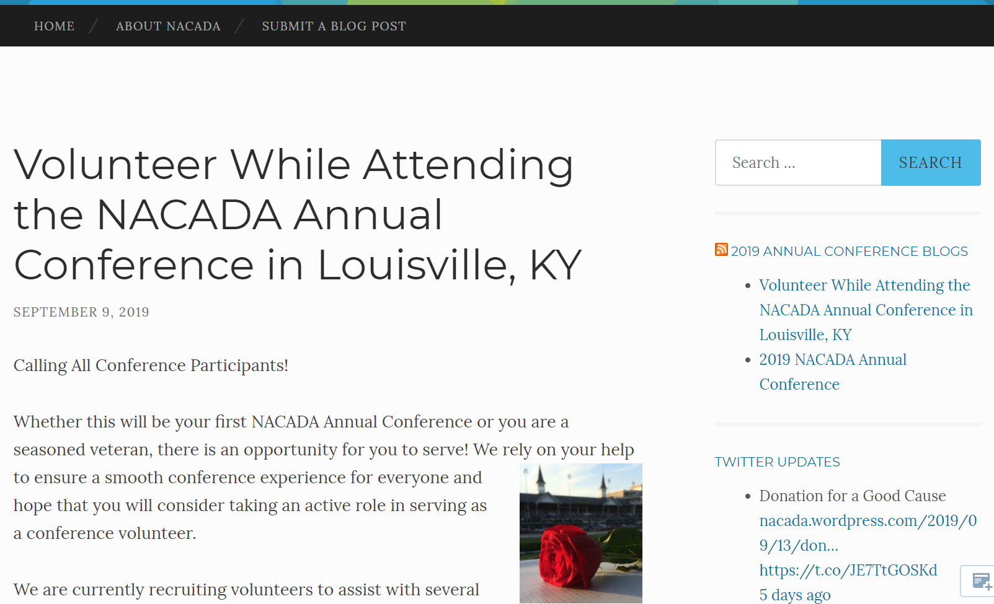
Notes:
A typical example of a blog post as part of the lead-up to an Annual Conference.
There is always room for more submissions to the blog!

Slide 15
The continuum of NACADA publications
Reviews:
Books
Articles
NACADA Blog
NACADA Review
NACADA Journal
AAT
Opinions welcome
Quickest turn-around

Slide 16
The NACADA Book Review
  A way of sharing valuable information with peers – making the literature accessible
  Reviewing a book is a great place to start as a new author
  Request, read and review
  Current members may review once each year
Upon publication: e-letter sent to administrator of choice
Published to http://www.nacada.ksu.edu/Resources/Book-Reviews.aspx
Email: bookrev@ksu.edu
ALSO . . . “Research Briefs” and “Research Article Reviews”
Notes:
Note: this is where we start with letters to your chosen administrator(s) . .. Important for recognition of your contributions to the literature…
Many NACADA authors began their writing for NACADA by completing a book review first!
Research Briefs: on the Research Center webpage (short abstract of an article others ought to read
Research article reviews: NACADA Review (deeper review of an article others ought to read . . . Implications and connections for advising practice)

Slide 17
The continuum of NACADA publications
Reviews:
Books
Articles
NACADA Blog
NACADA Review
NACADA Journal
AAT
Opinions welcome
Quickest turn-around
Juried critical review
Signed copyright release
Letter to administrator

Slide 18
Notes:
All of this information is found in the “Resources” tab of the NACADA website

Slide 19
Quarterly electronic publication (e-pub)
  Juried by Editorial Team
  Blind review as needed
Practical application of theory or research
~1000-1500 words not counting reference citations
APA (6th ed. through 2020) publication style preferred, MLA accepted (no footnotes)
Notes:
Editorial Team in Executive Offices makes most initial acceptance decisions, but when additional input is needed, submissions are sent out for blind review to a group of reviewers. All reviewers have written for this publication. They are listed on the AAT landing page.
In most cases, word limit is 1000 (minimum) – 1500 (maximum) – no more than 1500 words permitted
While APA format is strongly preferred, because the publication is THE VOICES OF THE GLOBAL COMMUNITY, we have left the door open for the possibility of the use of MLA (rare).

Slide 20
Draft acceptance rate ~ 60%
Critical Friends are key to a successful submission! Potential authors are encouraged to join one of NACADA’s Virtual Writing Groups or form one of their own.
Authors should seek primary editing assistance prior to submission. Final copy editing assistance is provided.
Submit your article via e-mail to Leigh Cunningham, Managing Editor, at Leigh@ksu.edu
Notes:
End up with a CLEAN manuscript, free of errors

Slide 21
The continuum of NACADA publications
Reviews:
Books
Articles
NACADA Blog
NACADA Review
NACADA Journal
AAT
Opinions welcome
Quickest turn-around
Juried critical review
Signed copyright release
Letter to administrator
Focused topic
Signed copyright release
Letter to administrator
Notes:
So, we’re building a continuum of venues that have a broad scope of audience and purpose …
Now let’s talk about some more in-depth publications…

Slide 22
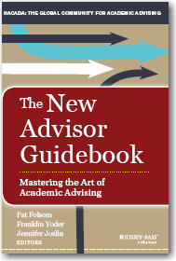



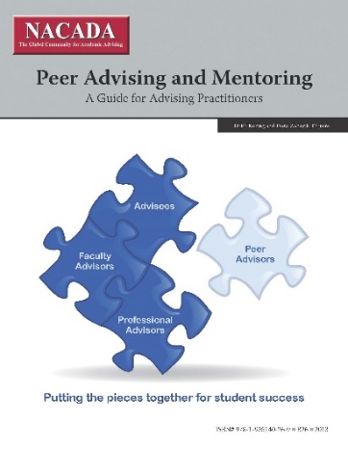
In-Depth NACADA publication opportunities
Pocket Guides
Books/chapters
NACADA Review
NACADA Journal
Notes:
Now . . . Moving along the continuum toward the NACADA Review, the NACADA Journal, and books …
Peer reviewed, our top scholarly publications

Slide 23
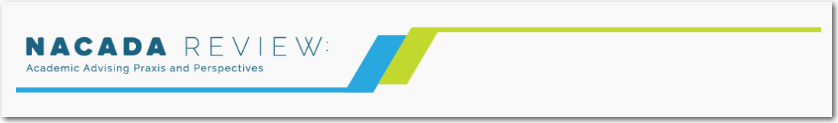
Local PRACTICE
RELEVANCE
FRAMING
“We found…” and “…we know this is a relevant issue because…”
“We found this interesting theory about advising, teaching and learning, etc…”
“…for which we found potential for specific application for others…”
Notes:
The NACADA Review puts theory-based application center stage. The articles published in the NACADA Review contribute to this process of ‘praxis’ by presenting ways in which practice can be understood in terms of theory, and theory can inform practice.
PRAXIS is the process that moves advisors from theory to practice, from thought to action.

Slide 24
NACADA Review: Academic Advising Praxis and Perspectives
Longer than AAT, more “contextual” than most NACADA Journal articles
Focused on high impact practices and perspectives that are still theoretically based
Example: Institutional initiatives with “lessons learned” and “implications for others”
May require IRB approval if data from participants are included
Peer-reviewed; 100% online, articles published when ready
Additional information can be found online: https://www.nacada.ksu.edu/Resources/NACADA-Review.aspx
Notes:
First issue is up!

Slide 25
The continuum of NACADA publications
Reviews:
Books
Articles
NACADA Blog
NACADA Review
NACADA Journal
AAT
Opinions welcome
Quickest turn-around
Juried critical review
Signed copyright release
Letter to administrator
Focused topic
Signed copyright release
Letter to administrator
Scholarly and contextual, with implications for practice
Letter to administrator
Notes:
Still do copyright release and letter to administrator, of course
Will add to the scholarly literature since this is a peer reviewed publication

Slide 26
Journal Purpose
The NACADA Journal exists to advance scholarly discourse about the research, theory, and practice of academic advising in higher education.
Professional publication
  Blind-reviewed
  Peer-refereed
Published twice a year
Scholarly articles on research, theory & practice
NACADA members receive a print copy. All articles can be accessed at www.nacadajournal.org.
Download the mobile app!

Slide 27
Journal Guidelines
Appropriate
Manuscripts should not exceed 6,000 words (excluding title page, abstract, and references)
Most articles based upon IRB-approved research that uses standard qualitative or quantitative research methodology, or humanities-based research, or theoretical analysis
Authors sign copyright release (can’t submit elsewhere until decision is made about acceptance)
Journal and APA style guides
  https://www.nacada.ksu.edu/Resources/Journal
Original
Applicable

Slide 28
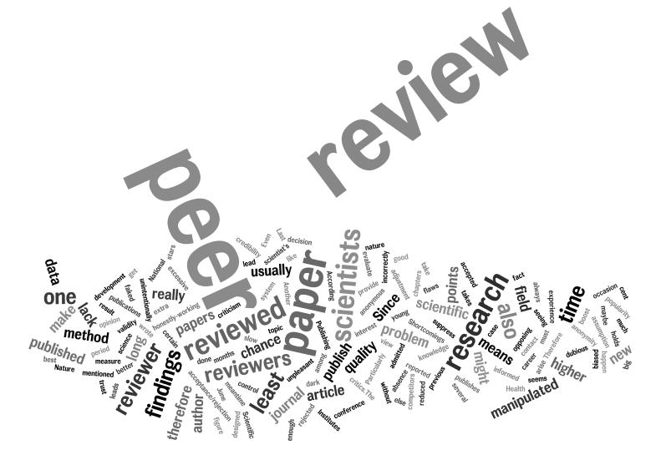
Manuscript Review Process (overall)
Co-Editors read each manuscript; determine readiness to go to Manuscript Reviewers
  Co-Editors work directly with authors if significant revision is needed before blind review
Three Manuscript Reviewers read article (no author identification) and write an independent review
Co-Editors read reviews and re-read manuscript
Co-Editors write an Editorial Decision Letter
  Decisions: Accept, Revise study/manuscript, Reject
Approximately 30% of manuscripts are published
Notes:
Here’s the process we go through upon initial submission into PeerTrack, our online editorial system…. Talk the points
Note: The majority of initial manuscripts are returned as “revise and resubmit.” Reviewers offer constructive critiques that, if followed, will lead to acceptance of the manuscript.
Manuscripts that are flat out rejected are usually because the topic is not the least bit related to advising; usually just an author “shopping” publications and have never actually read one article in the Journal, much less followed the guidelines.
Remember that the journal editors seek to expand the literature base within our field. For every manuscript published there are at least two where the authors just couldn’t schedule working on a revision into their schedule.
Perseverance and TIGHT ANALYTIC WRITING (and careful proofreading) wins with the Journal!

Slide 29
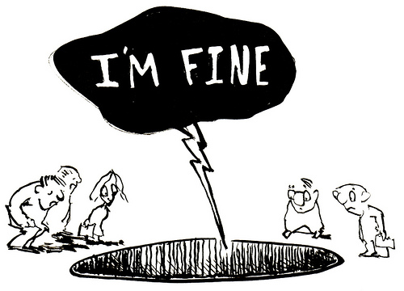
What happens after “revise and resubmit”?
Author decides whether to revise and lets the editors know of intent (author is given about 3 months to work on next draft)
  Note: Consider copyright release agreement
Author carefully considers the feedback from reviewers, reaches out to the co-editors and other critical friends, and re-writes
Manuscript is resubmitted, including a companion document that addresses the revisions made
  (hint for success: directly address the reviewers’ suggestions)
Revised manuscript goes back out to reviewers
Editorial decision is made
Notes:
Authors who don’t let editors know of plans to resubmit are stuck with copyright agreement….

Slide 30

What happens after acceptance?
Developmental copy editing process
Accepted manuscripts sent to the Copy Editor(s)
Edits
  Clarify meaning and eliminate jargon
  Check mechanics and APA compliance
  Check internal consistency of facts and citations
Author receives edited manuscript with queries where needed
Authors return manuscript to Copy Editor (quick turnaround)
Full editing process takes approx. one month

Slide 31

Tips for Getting Article Published
Become familiar with the publication
Place article in the context of previous articles on your topic
Follow all relevant guidelines (NACADA Review and NACADA Journal web sites, APA style guide 6th edition . . . soon to be 7th edition starting with 2021 publications)
Proofread to assure you are really finished
“Clean” manuscript for blind review; use cover sheet for identification information
Learn from the review process; schedule time to revise and then do it!
Include letter with revision detailing how you addressed reviewer comments
Notes:
Become familiar with types of articles in the NACADA Review and NACADA Journal including tone and style of writing
Emphasize PROOFREAD prior to submitting!
Note on bullet 3: the APA 6th edition doesn’t include the chapter on turning your dissertation into a journal article

Slide 32
The continuum of NACADA publications
Appropriate
Reviews:
Books
Articles
NACADA Blog
NACADA Review
NACADA Journal
AAT
Original
Opinions welcome
Quickest turn-around
Juried critical review
Signed copyright release
Letter to administrator
Focused topic
Signed copyright release
Letter to administrator
Scholarly and contextual, with implications for practice
Adds to the literature
Scholarly publication on original research
Adds to the literature
Applicable

Slide 33

And finally…
Notes:
Now will mention the opportunity to review existing NACADA publications

Slide 34
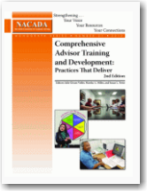
Editing and Reviewing Opportunities
What is reviewed?
  1st drafts written for NACADA-produced books and pocket guides
  NACADA books currently in print that are 6+ years old
Who’s involved? Members knowledgeable on the topic
Previous publishing experience is necessary for editors, and helpful (but not required) for reviewers
Look for “call for editors/reviewers” in NACADA mailings
Complete application online to be considered
Notes:
Important to keep NACADA resources up-to-date

Slide 35

How to get started
Become familiar with venue guidelines
Read, read, read!
Invite collaborators/reviewers; brainstorm “wonderings”
Set a time & place to write, and give yourself deadlines
Write, proofread, and review with “critical friends”
Revise based upon feedback and submit!
Join a NACADA writing group at: https://www.nacada.ksu.edu/Resources/Research-Center/Writer-Support.aspx
Notes:
We often send students to the campus writing center but many Writing Center directors enjoy helping professionals improve their writing!

Slide 36
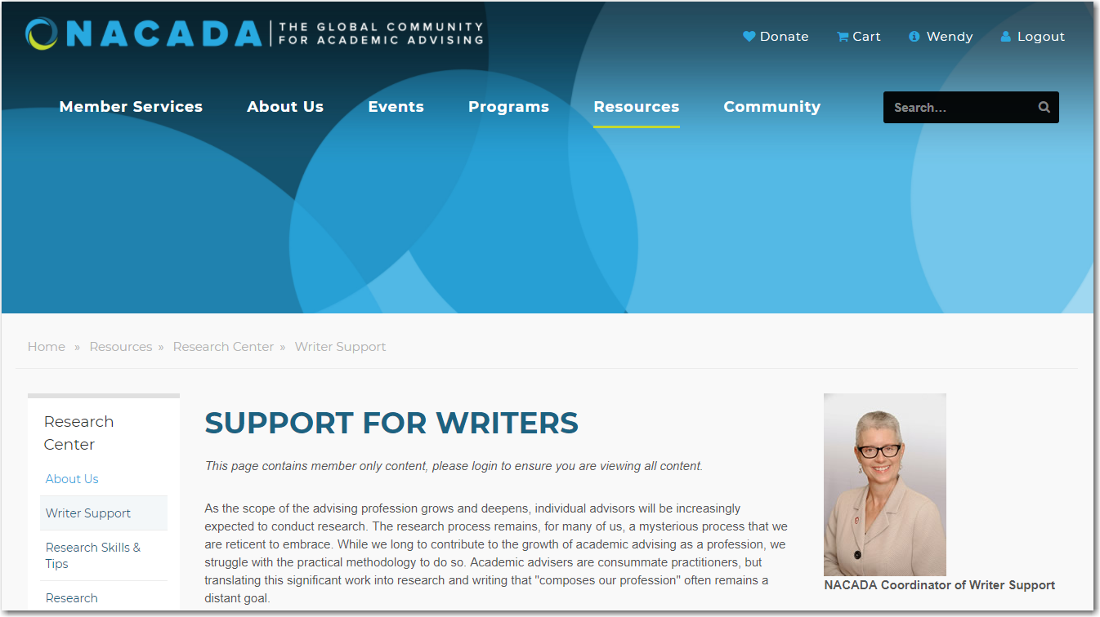
Notes:
New writer support program for ALL levels of abilities and confidence! Dr. Rhonda Dean-Kyncl (sounds like pencil) from the University of Oklahoma coordinates the program. We have three main groups . . . (next slide)

Slide 37
Virtual Writing Groups
  Group 1: Idea Generation
    To discuss ideas on how my unique experience could be transformed into an article or study
  Group 2: Idea Development
    To discuss with colleagues how I can move my idea forward
  Group 3: Drafting and Revising
    To gain and give critical feedback on manuscripts
  Opportunities for One-on-One Writing Consultation
    Quick virtual meeting to discuss the status of my project
  Also seeking mentors to assist the Idea Generation groups
Notes:
Groups of about 5 or 6 (you determine which type of group for your situation)
Members lead their own scheduling and process (with guidance from Rhonda at the start)
At the end of the “session” you decide whether to move on to the next type of group, stay where you are, or leave (totally up to you!)
Some groups stay together through the stages to manuscripts, others break up
(NOTE: might ask if anyone in the room is in a group now or has been in a writing group of any kind)

Slide 38
Writing Groups: Schedule and Expectations
Next Season: Fall 2020 – Summer 2021
Expectations for membership in this supportive peer review process:
Be “present” at all sessions (100% attendance is key)
Read deeply and reflectively (and they’ll do the same for you!)
Be a good “critical friend”
Give as much as you get (you learn from each other)
Notes:
Current groups will be together through this summer, then,
Sign-up for next academic year will open in the summer for the start of fall 2019.
Must be a NACADA member (logged in) to sign up
GREAT way to move your ideas forward toward publication, and maybe find collaborators

Slide 39
Notes:
All of this information is found in the “Resources” tab of the NACADA website

Slide 40
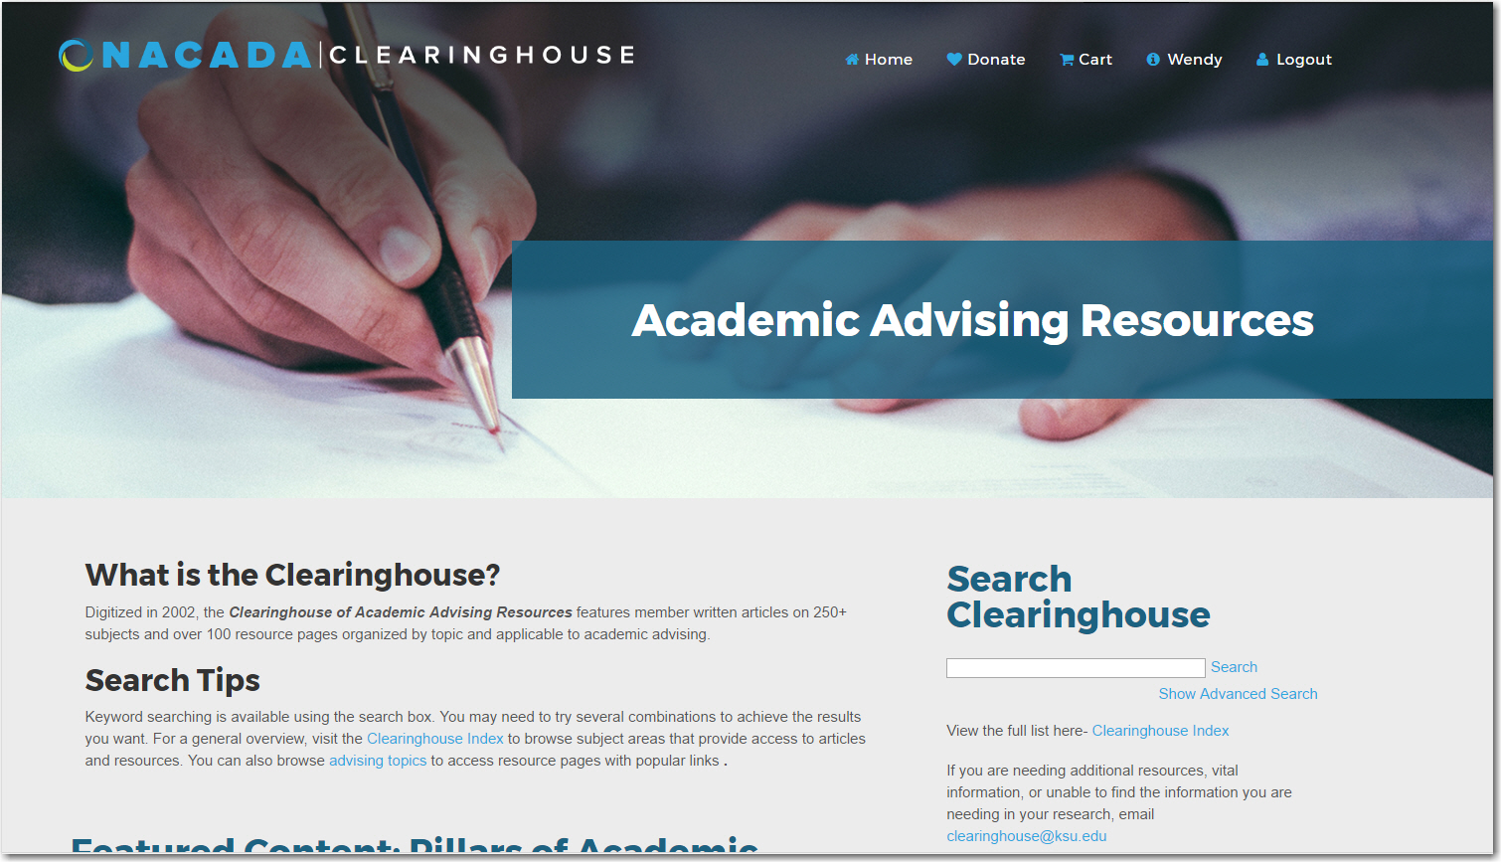
Notes:
Searchable, and always growing

Slide 41
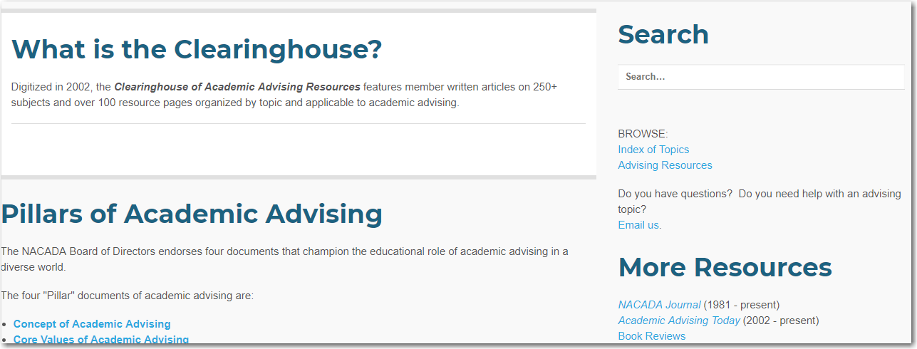
Notes:
Has many of NACADA’s “Pillar” documents, as well as connections to multiple resources we’ve talked about today.

Slide 42

Appropriate
Reviews:
Books
Articles
NACADA Blog
NACADA Review
NACADA Journal
AAT
Original
Opinions welcome
Quickest turn-around
Juried critical review
Signed copyright release
Letter to administrator
Focused topic
Signed copyright release
Letter to administrator
Scholarly and contextual, with implications for practice
Adds to the literature
Scholarly publication on original research
Adds to the literature
Applicable
Notes:
The Clearinghouse is a valuable repository of materials and contains references and links to all NACADA venues and publications.

Slide 43

POP QUIZ!!
Where would you send a piece about an interesting and important opinion from your unique viewpoint?
Where would you send an article based on your advising experience which could help others?
Where would you send a scholarly article based on formal (IRB approved) inquiry or philosophical analysis?
Where would you send an idea based on research or theory that will improve academic advising practice?
Notes:
Where would you send a piece about an interesting and important opinion from your unique viewpoint? The Blog
Where would you send an article based on your advising experience which could help others? AAT
Where would you send a scholarly article based on formal (IRB approved) inquiry or philosophical analysis? The NACADA Journal or the new NACADA Review
Where would you send an idea based on research or theory that will improve academic advising practice? Trick question . . . Applicable to all!

Slide 44

What will you write?
What topic?
What venue?
Final questions and comments?
Questions when you get home?
email publish@ksu.edu

Slide 45


Thank you for attending!
Please complete the session evaluation
Notes:
Don’t forget to mention the conference app or evaluation, if relevant!

